Slide 1
2017 Commonwealth Fund International Health Policy Survey of Older Adults
2017 Commonwealth Fund International Symposium
Washington, DC
November 15, 2017
Co-authors: Robin Osborn, Michelle M. Doty, Donald B. Moulds, Dana Sarnak, Arnav Shah

Slide 2

Meet Margaret
2017 INTERNATIONAL HEALTH POLICY SURVEY OF OLDER ADULTS
Margaret is 82 and frail.
She has diabetes, early
dementia, macular degeneration, and arthritis.
Margaret is taking 11 medications.
She has seen 5 specialists in the last three months.
Margaret lives on $20,000 a year.
She lives alone and is facing eviction from a formerly rent-stabilized apartment.

Slide 3
2017 INTERNATIONAL HEALTH POLICY SURVEY OF OLDER ADULTS
Methods:
20th annual survey; 7th survey on older and/or sicker adults
Views and experiences of adults 65 years and older in 11 countries
Total sample included 22,913 older adults
Samples sizes: Australia (2,500), Canada (4,549), France (750), Germany (751), Netherlands (750), New Zealand (500), Norway (750), Sweden (7,000), Switzerland (3,238), United Kingdom (753), United States (1,392)
Telephone Survey (with online component in Switzerland) conducted March to June 2017
Made possible with co-funding from country partners
Notes:
Slide 3 – Methods
In the 2017 International survey, the 20th in this international series, we spoke to 23,000 older adults (65 years and older) in 11 countries.
The survey was conducted by telephone
And, we were out in the field in March through June

Slide 4
Health Status, Functional Limitations, Utilization and
Economic and Social Vulnerability
2017 INTERNATIONAL HEALTH POLICY SURVEY OF OLDER ADULTS

Slide 5
Older Adults with Three or More Chronic Conditions*
Percent (%)
HEALTH STATUS, FUNCTIONAL LIMITATIONS, UTILIZATION AND ECONOMIC AND SOCIAL VULNERABILITY
UK
24
NOR
17
SWE
21
CAN
26
NET
17
GER
24
FRA
20
SWIZ
17
US
36
AUS
17
NZ
13
Source: 2017 Commonwealth Fund International Health Policy Survey of Older Adults
* Chronic conditions: joint pain or arthritis; asthma or chronic lung disease; cancer; diabetes; heart disease, including heart attack; hypertension or high blood pressure, and/or stroke.

Slide 6

Older Adults Needing Help with Housework, Meals, Daily Medications or Shopping Because of Their Health*
Percent (%)
HEALTH STATUS, FUNCTIONAL LIMITATIONS, UTILIZATION AND ECONOMIC AND SOCIAL VULNERABILITY
Source: 2017 Commonwealth Fund International Health Policy Survey of Older Adults

Slide 7
Older Adults Hospitalized in Last 2 Years
HEALTH STATUS, FUNCTIONAL LIMITATIONS, UTILIZATION AND ECONOMIC AND SOCIAL VULNERABILITY
France
Germany
16%
UK
NET
US
SWIZ
39%
CAN
NZ
SWE
AUS
NOR
0%
Percent hospitalized
50%
Note: All other countries between 25% and 29%.
Source: 2017 Commonwealth Fund International Health Policy Survey of Older Adults

Slide 8
Older Adults Who Regularly Take 4 or More Prescription Drugs
Percent (%)
HEALTH STATUS, FUNCTIONAL LIMITATIONS, UTILIZATION AND ECONOMIC AND SOCIAL VULNERABILITY
Source: 2017 Commonwealth Fund International Health Policy Survey of Older Adults

Slide 9
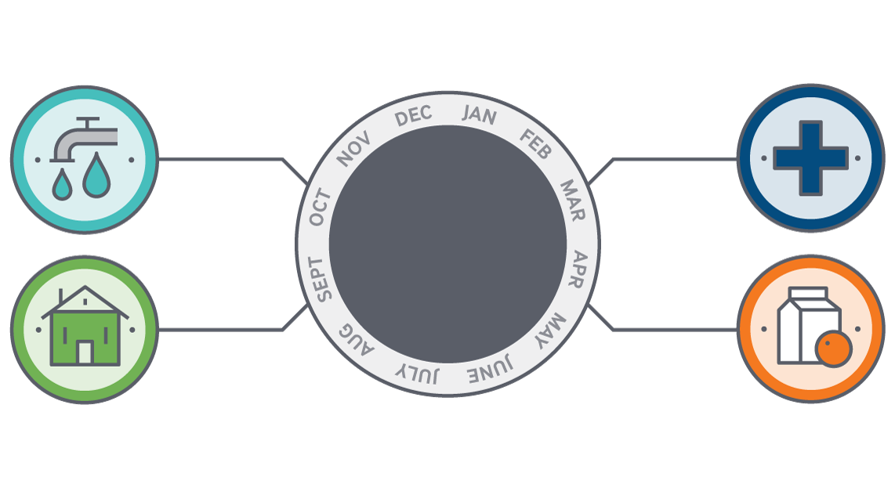
Economic Vulnerability
HEALTH STATUS, FUNCTIONAL LIMITATIONS, UTILIZATION AND ECONOMIC AND SOCIAL VULNERABILITY
Worried about having enough money to pay bills (electricity, heat, telephone)
Had serious problems paying medical bills
In the past
12 months, experienced one or
more of:
Worried about
having enough
money for rent/mortgage
Worried about
having enough money for healthy food

Slide 10

Older Adults who Experienced Economic Vulnerability in the Past Year*
HEALTH STATUS, FUNCTIONAL LIMITATIONS, UTILIZATION AND ECONOMIC AND SOCIAL VULNERABILITY
NOR
SWE
NZ
UK
NET
FR
SWIZ
10%
OR LESS
US
25%
Source: 2017 Commonwealth Fund International Health Policy Survey of Older Adults
*Economic vulnerability: "Always" or "usually" stressed or worried about having enough money to 1) buy nutritious meals, 2) pay rent or mortgage, 3) pay for other monthly bills like electricity, heat, and your telephone in the past year; and/or 4) having had problems paying or being unable to pay any medical bills in the past year.

Slide 11

Older Adults Who Lived Alone and Felt Socially Isolated*
Percent (%)
HEALTH STATUS, FUNCTIONAL LIMITATIONS, UTILIZATION AND ECONOMIC AND SOCIAL VULNERABILITY
Source: 2017 Commonwealth Fund International Health Policy Survey of Older Adults
* Respondent reported living alone and responded "often" or "some of the time" to the question: "How often do you feel isolated from others?" Possible answer categories were: “Hardly ever or never”, “some of the time” and “often”.

Slide 12
Affordability &
Cost-related Access Barriers
2017 INTERNATIONAL HEALTH POLICY SURVEY OF OLDER ADULTS

Slide 13
Older Adults Who Experienced Cost-related Access Problems to Care in Past Year *
Percent (%) who had to forgo care because of cost
AFFORDABILITY & COST-RELATED ACCESS BARRIERS
Source: 2017 Commonwealth Fund International Health Policy Survey of Older Adults
* Cost-related access problem in past year, including: 1) Did not see doctor when sick; 2) skipped medical test or treatment recommended by doctor; and/or 3) did not fill prescription or skipped doses because of the cost in past year.

Slide 14
Older Adults Facing High Out-of-pocket Costs in the Past Year ($2,000 or More)
Percent (%)
AFFORDABILITY & COST-RELATED ACCESS BARRIERS
Source: 2017 Commonwealth Fund International Health Policy Survey of Older Adults
Definition: Had out-of-pocket medical expenses of $2,000 or more in the past year

Slide 15

Older Adults Who Did Not Receive Needed Help with Activities of Daily Living Because of Cost
AFFORDABILITY & COST-RELATED ACCESS BARRIERS
ABOUT
20%
CAN*
AUS
US
OR MORE
*19%
SWE
FR
NET
UK
SWIZ
10%
OR LESS
Source: 2017 Commonwealth Fund International Health Policy Survey of Older Adults
Definition: Older adults with functional limitations who did not receive the help they needed with their functional limitations due to cost.
Population: Older adults with functional limitations (because of a health problem needs someone to help them with housework, preparing meals, managing daily medications or shopping).
Data not shown: Germany, New Zealand and Norway excluded due to small sample size (<100 respondents).

Slide 16
Timeliness of Care
2017 INTERNATIONAL HEALTH POLICY SURVEY OF OLDER ADULTS

Slide 17

Older Adults Reporting They Often/Always Did Not Hear Back From Regular Doctor on Same Day, When Contacted with a Medical Concern
Percent (%)
TIMELINESS OF CARE
Source: 2017 Commonwealth Fund International Health Policy Survey of Older Adults
Definition: Did not always or often hear from regular doctor on same day, when contacted doctor with a medical concern. Possible responses: “always,” “often,” “sometimes,” and “rarely or never”.
Population: Excluding adults who did not report having a regular doctor or place of care and who never tried to contact their doctor.

Slide 18

Older Adults Who Waited 6 days or More for an Appointment
Percent (%)
TIMELINESS OF CARE
Source: 2017 Commonwealth Fund International Health Policy Survey of Older Adults
Long wait time: Waited six days or more for an appointment to see someone when sick.
Population: Excludes adults who did not need to make an appointment.

Slide 19

Older Adults Who Had Difficulty Getting After-hours Care Without Going to the ED
Percent (%)
TIMELINESS OF CARE
Source: 2017 Commonwealth Fund International Health Policy Survey of Older Adults
Definition: “Somewhat” or “very difficult” to get after-hours care.
Population: Excludes adults who did not need after-hours care.
ED, Emergency Department.

Slide 20
Patient Engagement and Health Promotion
2017 INTERNATIONAL HEALTH POLICY SURVEY OF OLDER ADULTS

Slide 21
Older Adults Who Talked With Doctor About Health Promotion in Last 2 Years
PATIENT ENGAGEMENT AND HEALTH PROMOTION
✓ = 50% or More Reported Talking With Doctor About Health Promotion
 | Falls, among those at moderate or high risk of falls | Healthy diet and exercise and physical activity | Things in life that cause stress like depression and anxiety
AUS | ✓
CAN
FR | ✓
GER
NET
NOR
NZ | ✓
SWE
SWIZ | ✓
UK
US | ✓ | ✓
Source: 2017 Commonwealth Fund International Health Policy Survey of Older Adults
Definition: During past two years, talked with doctor or other clinical staff at regular place of care about healthy diet, exercise and physical activity; things in life that cause stress; or falls, among whose self-perceived risk of falling is high or moderate.

Slide 22
Experiences of High-need Older Adults
2017 INTERNATIONAL HEALTH POLICY SURVEY OF OLDER ADULTS

Slide 23



‘High-need’ Definition Among Older Adults Aged 65 Years or Over
EXPERIENCES OF HIGH-NEED OLDER ADULTS
Chronic Conditions
3 or more:
Functional Limitations
Because of health, needed help with activities of daily living:
Joint pain or arthritis
Housework
Asthma or chronic
lung disease
AND / OR
Meals
Cancer
Daily medications
Diabetes
Shopping
Heart disease,
including heart attack
Bathing
Hypertension/high blood pressure and/or stroke
Dressing

Slide 24
Percent of Older Adults with ‘High-needs’ (%)
EXPERIENCES OF HIGH-NEED OLDER ADULTS
Source: 2017 Commonwealth Fund International Health Policy Survey of Older Adults
High-need definition: Percent of older adults with either three or more chronic conditions or functional limitations.

Slide 25
High-need Older Adults Experience Greater Economic Vulnerability*
EXPERIENCES OF HIGH-NEED OLDER ADULTS
Not high-need
High-need
US *
AUS *
GER *
CAN *
SWIZ *
NET *
NZ *
UK *
FR
NOR *
SWE *
Percent of older adults
Source: 2017 Commonwealth Fund International Health Policy Survey of Older Adults
Population: High-need older adults are defined as having three or more chronic conditions or a functional limitation.
*Economic vulnerability: "Always" or "usually" stressed or worried about having enough money to 1) buy nutritious meals, 2) pay rent or mortgage, 3) pay for other monthly bills like electricity, heat, and your telephone in the past year; and/or 4) having had problems paying or being unable to pay any medical bills in the past year.
Asterisk(*) indicates that the differences between high need and not high need are significant below p<0.05.

Slide 26
High-need Older Adults Experience Greater Cost Barriers to Receiving Care*
EXPERIENCES OF HIGH-NEED OLDER ADULTS
Not high-need
High-need
US *
AUS *
NZ
GER
CAN *
SWIZ
NET
UK *
NOR
FR
SWE
Percent of older adults
Source: 2017 Commonwealth Fund International Health Policy Survey of Older Adults
Population: High-need older adults are defined as having three or more chronic conditions or a functional limitation.
* Cost-related access problem in past year, including: 1) Did not see doctor when sick; 2) skipped medical test or treatment recommended by doctor; and/or 3) did not fill prescription or skipped doses because of the cost in past year.
Asterisk(*) indicates that the differences between high need and not high need are significant below p<0.05.

Slide 27
High-need Older Adults Experience Greater Emotional Distress*
EXPERIENCES OF HIGH-NEED OLDER ADULTS
Not high-need
High-need
AUS *
NET *
GER *
US *
CAN *
SWIZ *
NZ *
FR *
UK
NOR *
SWE *
Percent of older adults
Source: 2017 Commonwealth Fund International Health Policy Survey of Older Adults
* Emotional distress includes anxiety or depression in the past year.
Population: High-need older adults are defined as having three or more chronic conditions or a functional limitation.
Asterisk(*) indicates that the differences between high need and not high need are significant below p<0.05.

Slide 28
High-need Older Adults Experience More Care Coordination Problems*
EXPERIENCES OF HIGH-NEED OLDER ADULTS
Not high-need
High-need
GER
US *
SWIZ *
AUS *
CAN *
UK
SWE *
NET *
FR *
15
Percent of older adults
Source: 2017 Commonwealth Fund International Health Policy Survey of Older Adults
* Care coordination problem: 1) Test results/records not being available at appointment or duplicate tests ordered; 2) specialist lacked medical history or regular doctor not informed about specialist care; and/or 3) received conflicting information from different doctors or health care professionals in the past two years.
Population: High-need older adults are defined as having three or more chronic conditions or a functional limitation.
Data not shown: New Zealand and Norway excluded due to sample size n<100.
Asterisk(*) indicates that the differences between high need and not high need are significant below p<0.05.

Slide 29
High-need Older Adults Experience Higher Patient Dissatisfaction with Care Quality*
EXPERIENCES OF HIGH-NEED OLDER ADULTS
Not high-need
High-need
AUS *
CAN *
FR
NET *
UK *
GER
US
NOR *
SWE *
NZ
SWIZ *
Percent of older adults
Source: 2017 Commonwealth Fund International Health Policy Survey of Older Adults
* Somewhat or not at all satisfied with the quality of care received in the past year. Possible answer categories were: "completely satisfied," "very satisfied," "somewhat satisfied" or "not at all satisfied.“
Population: High-need older adults are defined as having three or more chronic conditions or a functional limitation. Excludes those who did not receive care in the past year.
Asterisk(*) indicates that the differences between high need and not high need are significant below p<0.05.

Slide 30
What Have We Learned About the Health Care Needs and Experiences of Older Adults?
2017 INTERNATIONAL HEALTH POLICY SURVEY OF OLDER ADULTS

Slide 31
Lessons Learned from 2017 International Health Policy Survey
2017 INTERNATIONAL HEALTH POLICY SURVEY OF OLDER ADULTS
U.S. seniors are sicker, more economically vulnerable, and face greater financial barriers to medical care and social care than elderly in the 10 other countries
Benefit design matters
Older adults across countries face gaps in timely access to care
Across countries, health promotion is a missed opportunity
Strengthening the social safety net is critical for addressing the challenges facing high-need elderly
Innovative programs are needed for high-need elderly that address both health and social care needs

Slide 32
Acknowledgements
2017 INTERNATIONAL HEALTH POLICY SURVEY OF OLDER ADULTS
With thanks to co-authors Don Moulds, Michelle Doty, Dana Sarnak and Arnav Shah, to SSRS, and Roosa Tikkanen for contributions to the content and production of this presentation.
SPECIAL THANKS TO OUR COUNTRY CO-FUNDERS:
  Australia: New South Wales Bureau of Health Information and Victoria Department of Health and Human Services
  Canada: Canadian Institute for Health Information, Canadian Institutes of Health Research, Health Quality Ontario, and Commissaire à la Santé et au Bien-être du Québec
  France: Haute Autorité de Santé and Caisse Nationale d’Assurance Maladie des Travailleurs Salariés
  Germany: Federal Ministry of Health and Federal Institute for Quality Assurance and Transparency in Health Care (IQTIG)
  Netherlands: Ministry of Health, Welfare, and Sport and the Scientific Institute for Quality of Healthcare at Radboud University Nijmegen Medical Centre
  Norway: Norwegian Knowledge Centre for the Health Services
  Sweden: Ministry of Health and Social Affairs and the Swedish Agency for Health and Care Services Analysis
  Switzerland: Federal Office of Public Health

